Slide 1
UDN Overview - 2019 UGRP-
Jemin Lee
Information and Communication Engineering
Daegu Gyeongbuk Institute of Science and Technology (DGIST)
jmnlee@dgist.ac.kr
Feb. 21, 2019

Slide 2
Outline
Part 1 - Ultra-Dense Network (UDN) Overview
Part 2 – UDN Modeling
Part 3 – UDN Performance

Slide 3
Part 1
UDN Overview

Slide 4
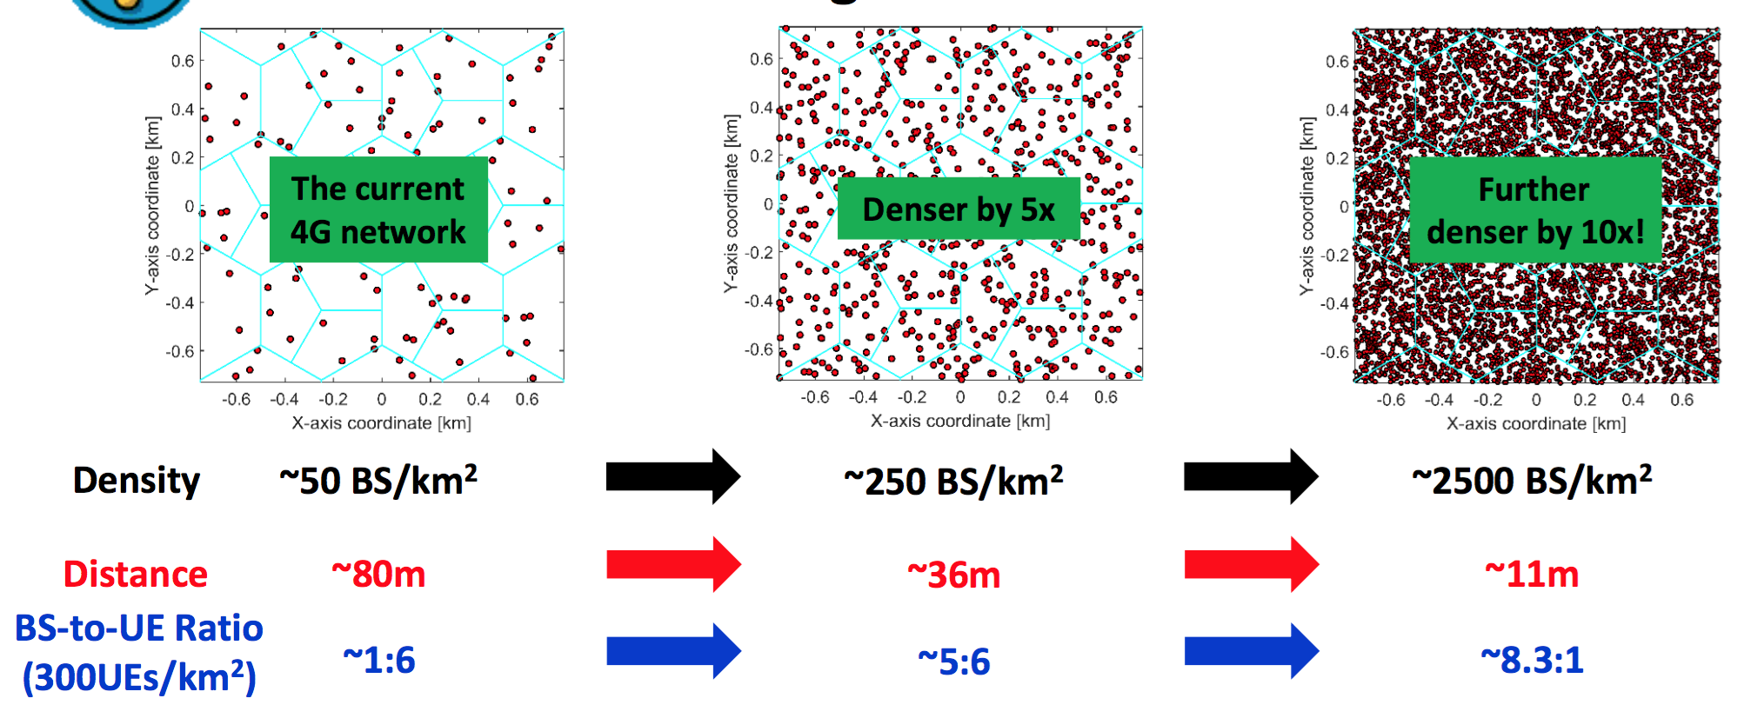
Ultra-Dense Network (UDN)
Dense and massive deployments of small-cell BSs
Core element to realize the vision of 5G
Higher data rates and enhanced coverage
Notes:
모바일 사용자의 트래픽 수요가 폭등하면서 5G에서는 주요 후보 기술 분야로 기지국 간 거리가 매우 가까운 초고밀도 네트워크가 있다.
UDN에서 상대적으로 많은 기지국들을 통해서 높은 주파수 효율과 데이터 전송 속도를 보장할 수 있다.

Slide 5
Ultra-Dense Network(UDN)
Comparison between UDN and the traditional cellular network
ITEM | UDN | Traditional cellular network
Deployment Scenarios | Indoor, Hotspot | Wide coverage
AP density | More than 1000/km² | 3-5/km²
AP Coverage | Around 10m | Several hundred meters and more
AP types | Small-Cell, Pico, Femto, UE relay, Relay | Macro/Micro BS
AP Backhaul | Ideal/Non-ideal, Wired/Wireless | Ideal, Wired
User Density | High | Low/Medium
User Mobility | Low mobility | High mobility
Traffic density | High | Low/Medium
Deployment | Heterogeneous, irregular | Single layer, regular cell
System Bandwidth | Hundreds of MHz | Tens of MHz
Spectrum | >3GHz (up to mm Wave) | <3GHz
[Sha:17] Chen, Shanzhi, et al. "Ultra-Dense Network Architecture and Technologies for 5G." 5G Mobile Communications. Springer International Publishing, 2017. 403-429.
Notes:
Ideal Backhaul: 2.5$μsec$ 이하의 지연과 10Gbps 이상의 capacity를 갖는 backhaul
Non-ideal Backhaul: 5~30 msec (혹은 그 이상)의 지연을 갖는 backhaul

Slide 6
Why are Dense SCNs Different?
Dense Small Cell Networks (SCNs) are different:
Stronger interference due to the transition from NLoS to LoS
Capped signal due to the BS-to-UE antenna height difference
BS diversity gain due to a surplus of base stations than users
UE diversity loss due to a small number of UEs in each cell
D. Lopez-Perez, M. Ding, H. Claussen, A. Jafari, “Towards 1Gbps/UE: Understanding Ultra Dense Small Cell Deployments,” IEEE Comm. Surveys & Tutorial, 2015

Slide 7
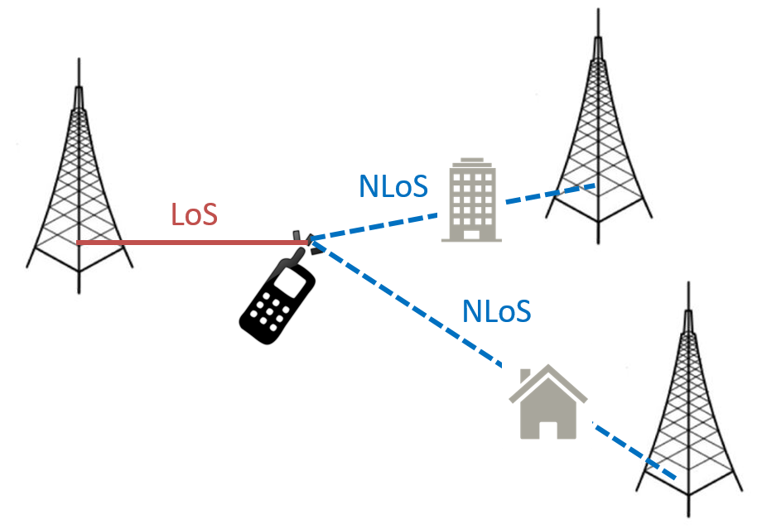
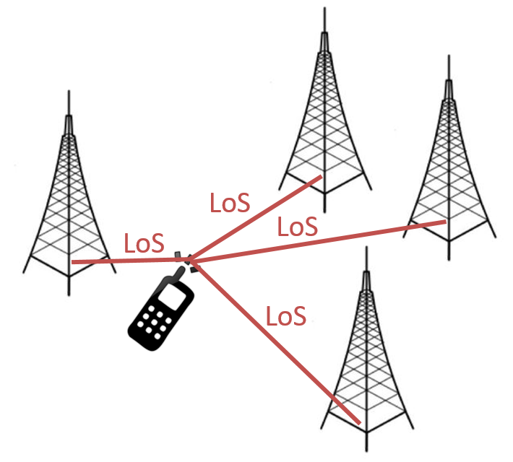
Transition from NLoS to LoS
Probabilistic LoS and NLoS transmissions
UE may be associated with a BS having a LoS path to the UE
UDN
Interfering BSs
Serving BS
Interfering BSs
Serving BS
Due to the densification of BSs in UDN, both serving BS and interfering BSs may have a LoS path to the UE
Ding, Ming, et al. "Performance impact of LoS and NLoS transmissions in dense cellular networks." IEEE Transactions on Wireless Communications 15.3 (2016): 2365-2380.

Slide 8
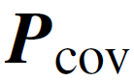
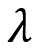
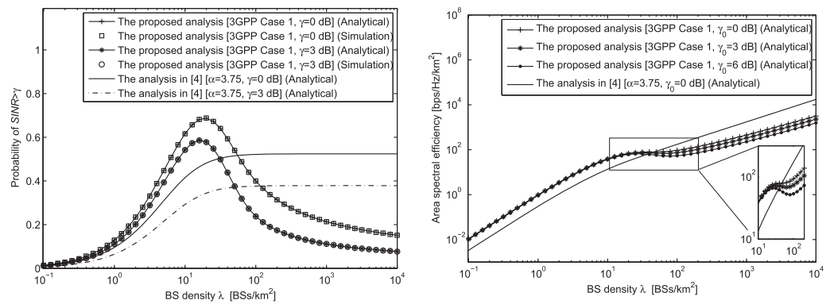
Transition from NLoS to LoS
Stronger Interference due to the Transition from NLoS to LoS
Probabilistic LoS/NLoS transmissions:
decreases as increases when the network is dense enough.
Due to the transition of a large number of interference paths from NLoS to LoS
ASE decreases as increases in some range.
Due to the quick decrease of the
Ding, Ming, et al. "Performance impact of LoS and NLoS transmissions in dense cellular networks." IEEE Transactions on Wireless Communications 15.3 (2016): 2365-2380.
Notes:
NLoS transmission: $P_{cov}$ is independent with the BS density $λ$ when $λ$ is large enough.
Increase in interference and signal power cancel each other
NLoS transmission: ASE increases linearly with the BS density $λ$.
$P_{cov}$ is invariable with respect to $λ$

Slide 9

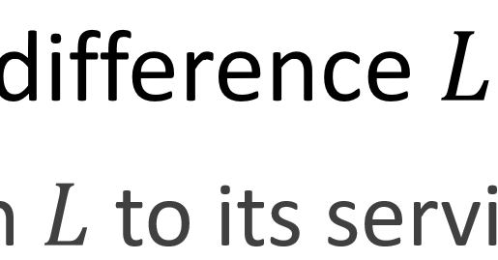
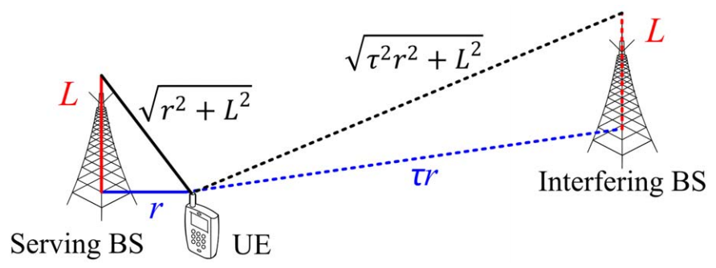
BS Antenna Heights
BS-to-UE antenna height difference is not negligible
UE cannot be closer than to its serving BS
A cap on the signal power
If is larger than zero, then the ASE performance will continuously decrease with network densification for UD SCNs.
Ding, Ming, and David López Pérez. "Please lower small cell antenna heights in 5G." Global Communications Conference (GLOBECOM), 2016 IEEE. IEEE, 2016.

Slide 10
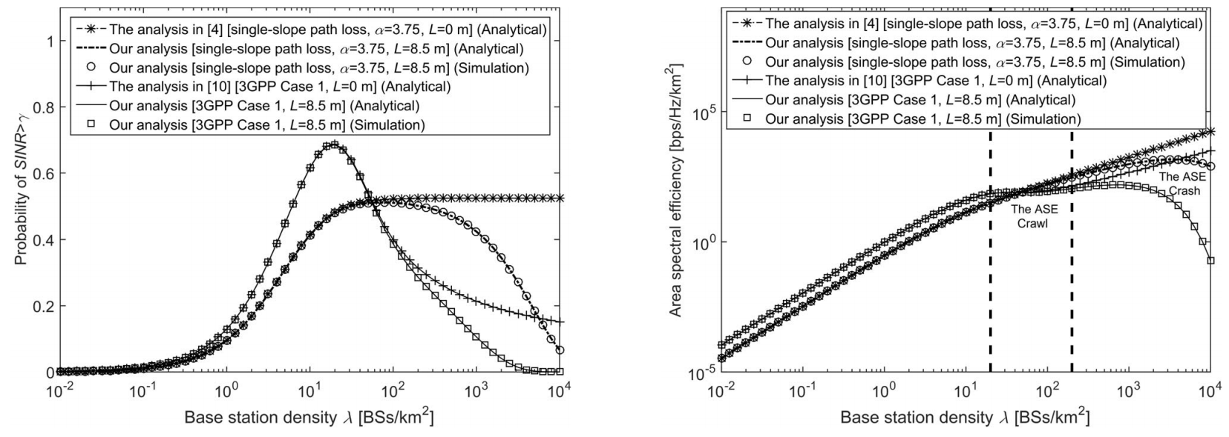
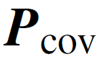
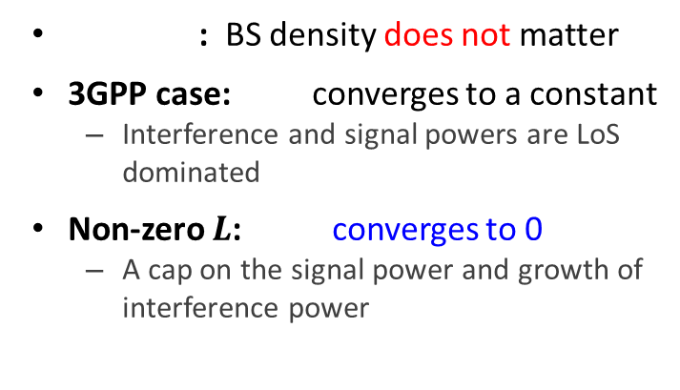
BS Antenna Heights
Weaker Signal due to the BS-to-UE Antenna Height Difference
: ASE increases linearly
3GPP case: ASE crawls
Transition from NLoS to LoS
Non-zero : ASE crashes
Sever performance loss in UD SCNs
A cap imposed on the signal-link distance and signal power
: BS density does not matter
3GPP case: converges to a constant
Interference and signal powers are LoS dominated
Non-zero $L$: converges to 0
A cap on the signal power and growth of interference power
Ding, Ming, and David López Pérez. "Please lower small cell antenna heights in 5G." Global Communications Conference (GLOBECOM), 2016 IEEE. IEEE, 2016.

Slide 11
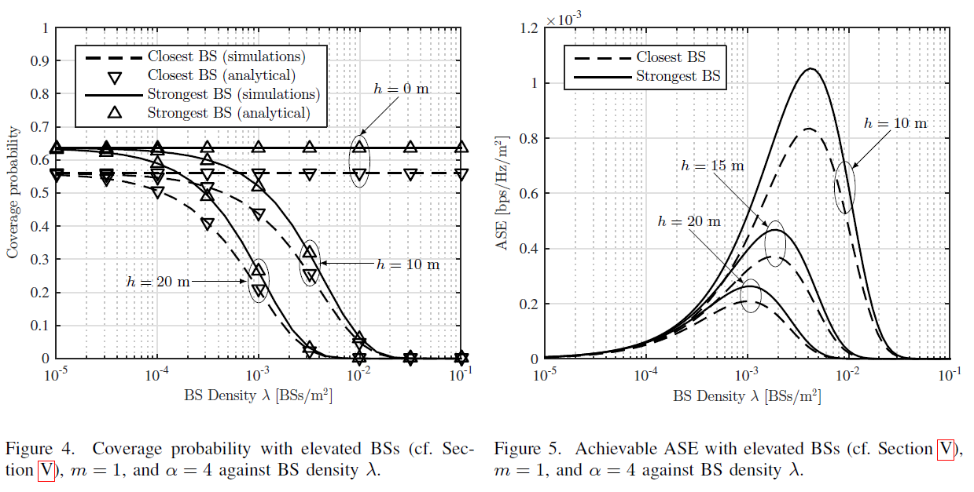
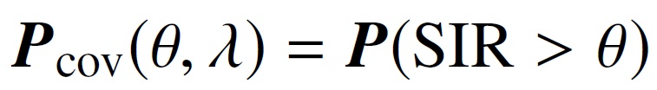
Elevated Base Stations
Effect of BS height on the network performance
Lower received signal power
(Bounded pathloss)
BS Height
Network Performance
Lower interfering signal power
Detrimental Effect of BS Height
Atzeni, Italo, Jesús Arnau, and Marios Kountouris. "Downlink cellular network analysis with LOS/NLOS propagation and elevated base stations." arXiv preprint arXiv:1703.01279 (2017).
Notes:
Serving BS가 BS height 보다 더 가까이 있을 수는 없기 때문에 Signal power는 제한되지만, BS 밀도가 높아지면서 Interfering BS의 개수가 많아져 Interference power는 더 높아져 결과적으로 coverage probability와 ASE는 BS높이가 높아짐에 따라 감소하게된다.

Slide 12
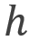
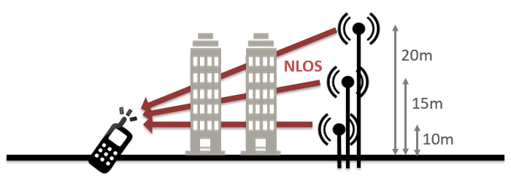
Elevated Base Stations
Cellular Network with Elevated Base Stations (not a UDN)
System Model
Bounded pathloss model
BS cannot be closer than the height of BS,
NLoS transmission only
Rayleigh fading, same pathloss exponent for NLoS and LoS
Atzeni, Italo, Jesús Arnau, and Marios Kountouris. "Downlink cellular network analysis with LOS/NLOS propagation and elevated base stations." arXiv preprint arXiv:1703.01279 (2017).

Slide 13
Part 2
UDN Modeling

Slide 14
Things to Think for UDN Modeling (1/2)
Base station distribution
Density?
How to distribute?
Mobile user distribution
Density?
How to distribute?
BS association
BS with average strongest received power
BS with instantaneous strongest received power

Slide 15
Things to Think for UDN Modeling (2/2)
Channel Modeling
LoS probability?
Channel fading?
Interference Modeling
Co-channel interference from all BSs (Downlink case) or parts of BSs?

Slide 16
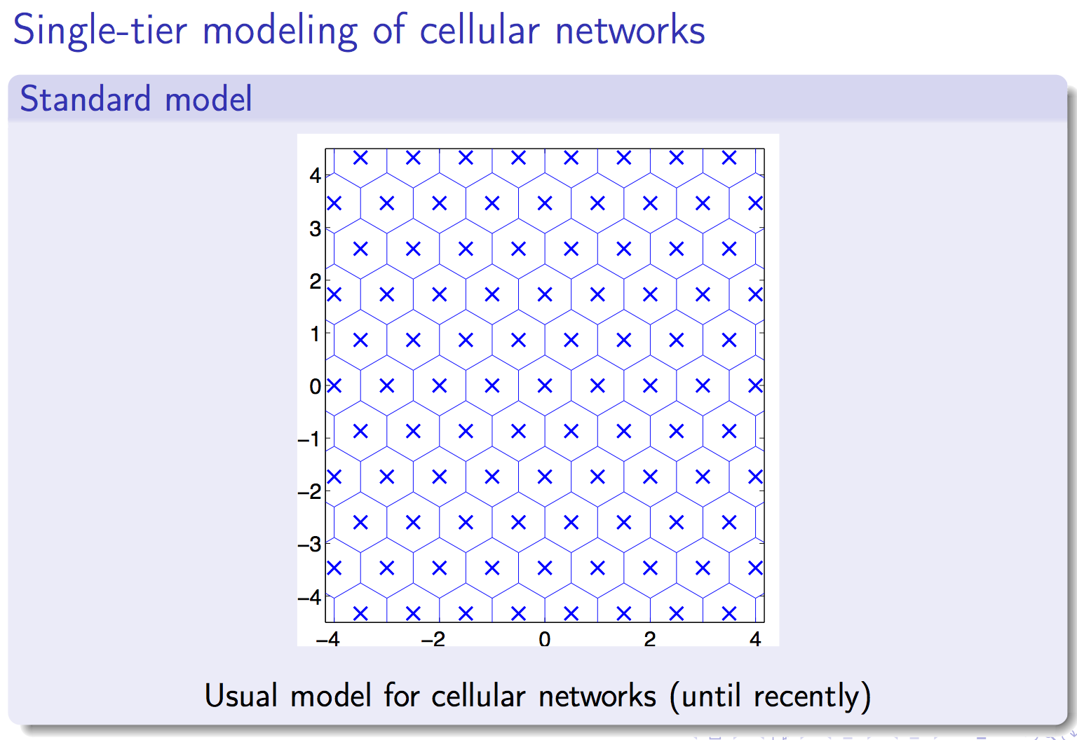
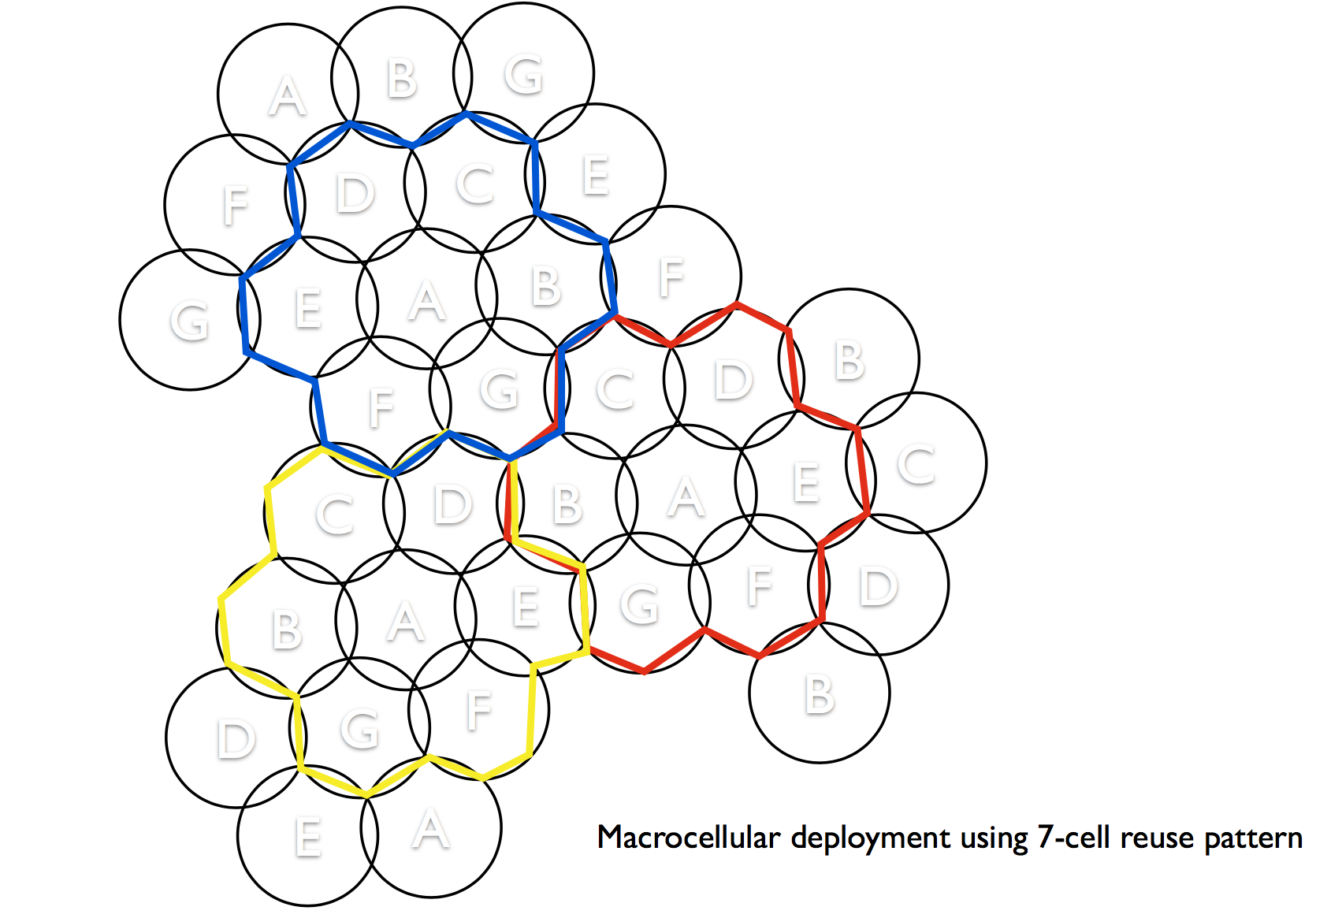
Base station distribution
Conventional Cell – Hexagonal Cells

Slide 17
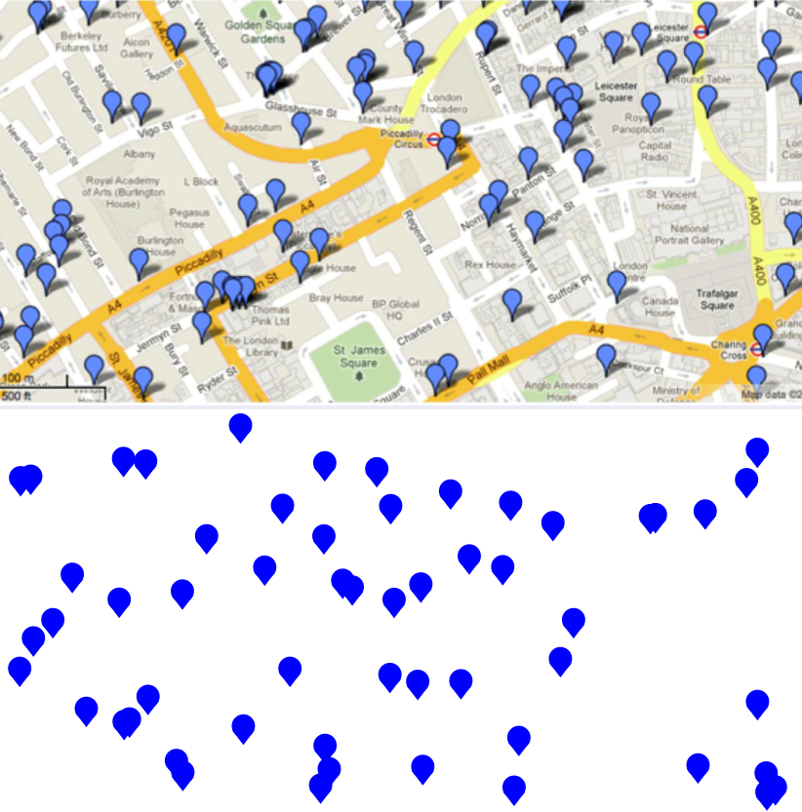
Base station distribution
Poisson distributed base stations?

Slide 18
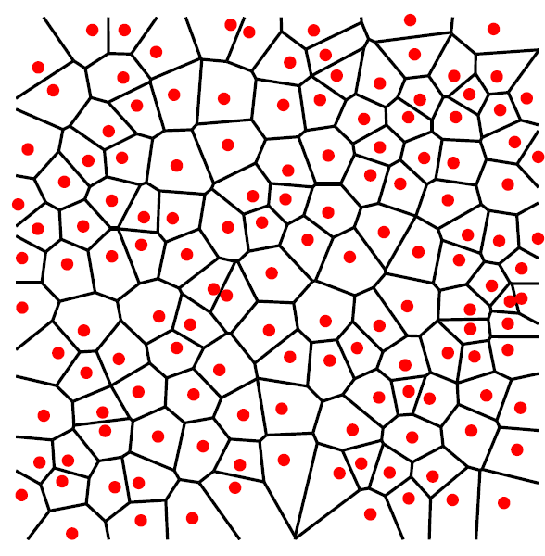
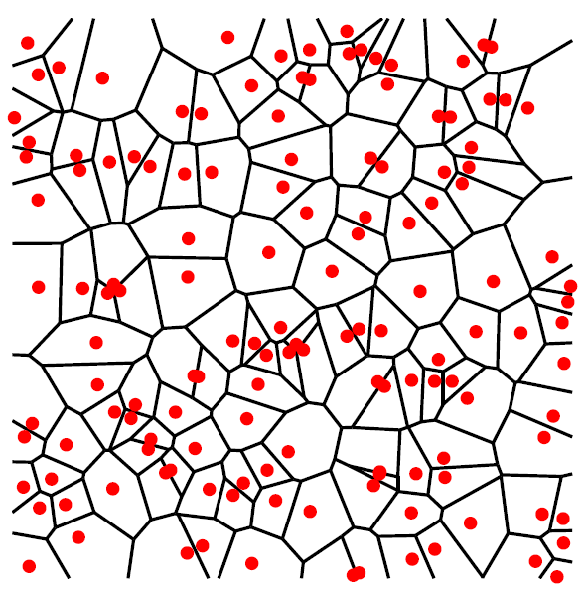
Base station distribution
확률 기하(stochastic geometry)
공간상 무작위의 패턴을 분석하는 학문
고밀집 네트워크 연구에서 최적의 이론적 분석 방법
실제 기지국 분포 vs. PPP(Poisson Point Process) 기지국 분포^{[1]}
실제 미국의 LTE 기지국 분포 (40km x 40 km)
실제 기지국과 PPP 기지국 분포가 상당히 유사함
$$𝒫_{cov}=ℙ\left[SINR>β_{o}\right]$$
<(좌) 실제 LTE 기지국 분포, (우) 동일 밀도를 갖는 PPP 기지국 분포 >
<기지국 분포 방식에 따른 커버리지 확률 비교>

Slide 19
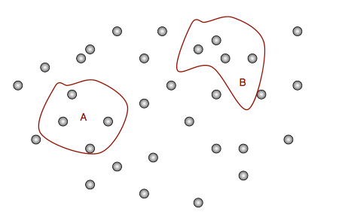
Base station distribution – PPP
Definition of Poisson Point Process (PPP)
Consider the count function for a point process
A Poisson point process (PPP) on is a random countable subset of such that
1) for any disjoint measurable subsets of ,
the random variables are independent
2) has the Poisson distribution with mean
where

Slide 20
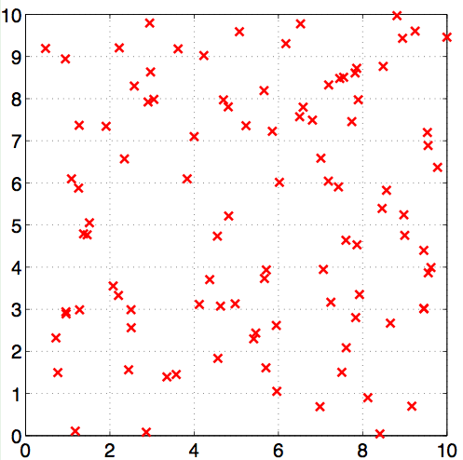
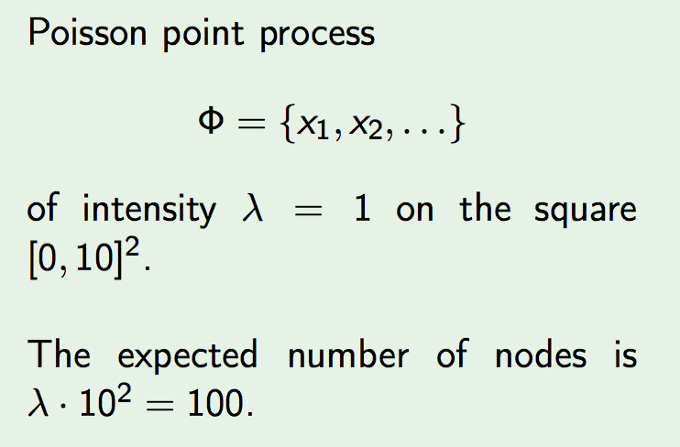
Base station distribution – PPP
PPP is perhaps the most well-studied point process
No dependence between node locations
Random number of nodes
Can be defined on the entire plan
An Example of PPP

Slide 21
Base station distribution – PPP
How to simulate a PPP of density on A = [-L,L]² ?
1) The number of points in the set A is a Poisson random variable with mean
2) Conditioned on the number of points, the points are uniformly distributed as a BPP on A
Can generate one realization of a PPP
Need to repeat to obtain average behavior

Slide 22
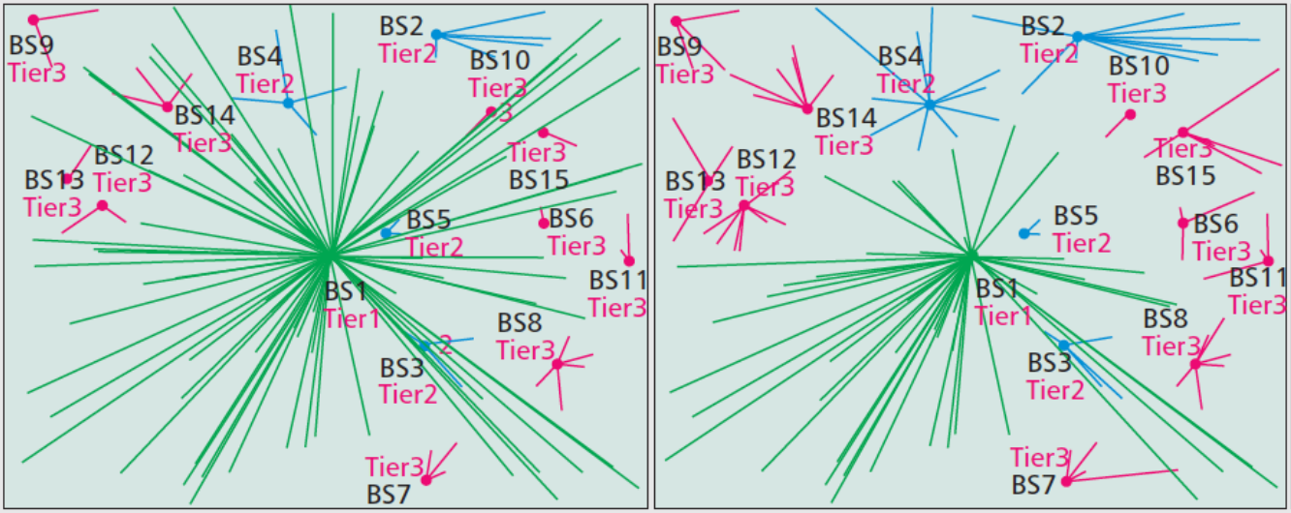
BS Association Rule
BS (or AP) Association
“Biasing” in Association
To push users off from heavily loaded macrocell to lightly loaded small cell
Fixed or adaptive or random biasing
Optimal Association: Massive Combinatorial Optimization Problem
SINR for every user to every BS
Instantaneous load at each BS
Choices of other users in the network
Instantaneous max SINR Association
(Biased) Average Max Received Power Association
* [And14]
[And14] J. G. Andrews et al., “An Overview of Load Balancing in HetNets: Old Myths and Open Problems”, IEEE Wireless Commun., 2014.
Notes:
to make a user associate with lower sINR than the maceocell

Slide 23
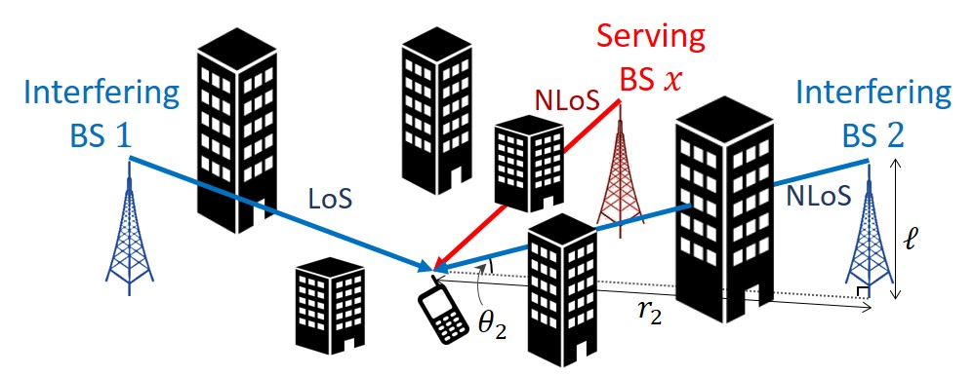
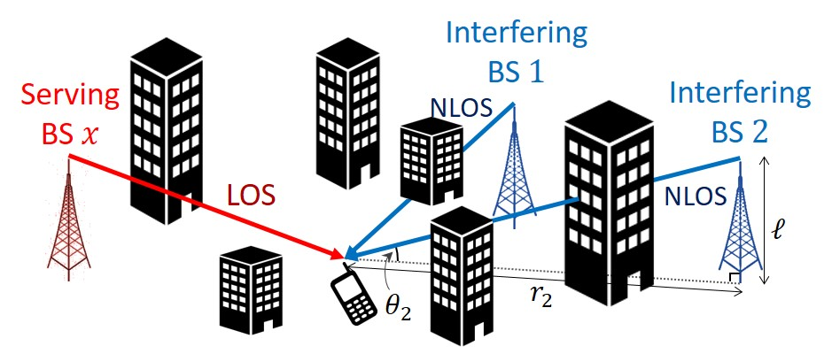
BS Association Rule
“Average” Strongest BS Association Rule
Due to the different pathloss exponent for LoS and NLoS propagation, the nearest BS may not transmit the strongest power
Different distribution of the main link distance depending on whether the serving BS forms LoS or NLoS Propagation

Slide 24
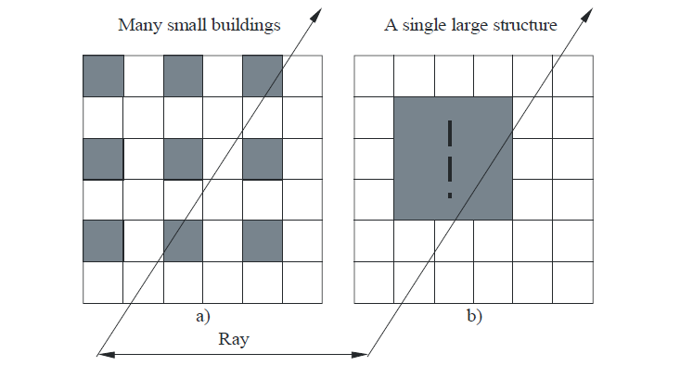
Channel Modeling
LoS Link? Or NLoS Link?

Slide 25
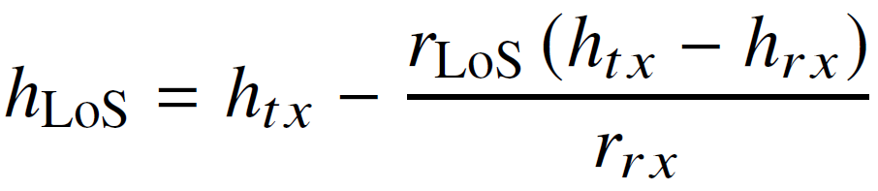
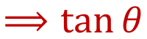
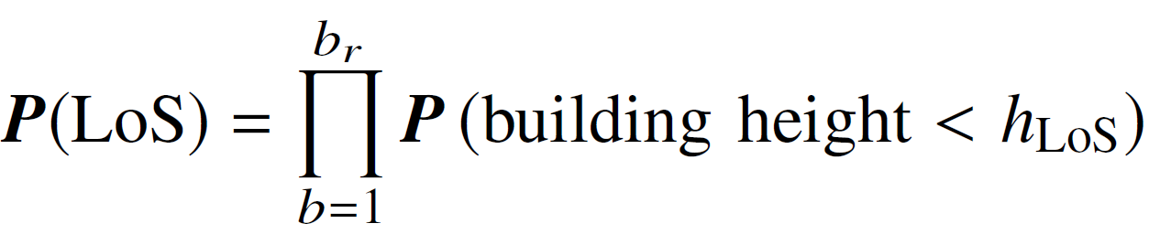
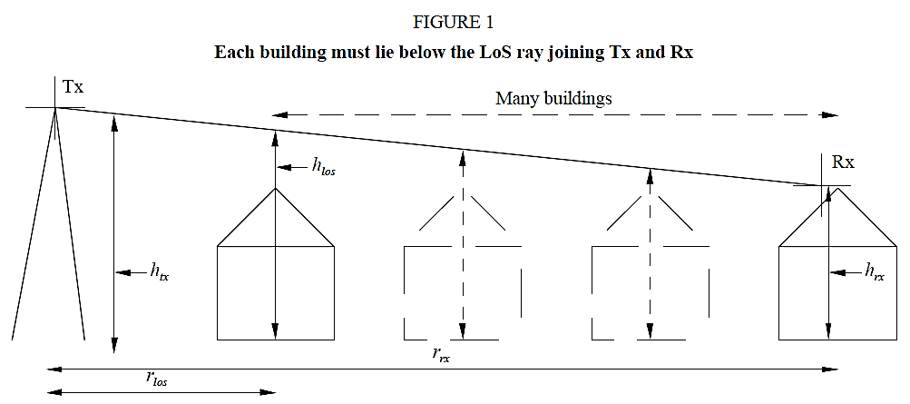
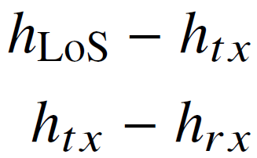
Channel Modeling - LoS Probability
Height of the ray at the obstruction point,
Probability that a LoS ray exists
Propagation data and prediction methods required for the design of terrestrial broadband radio access systems operating in a frequency range from 3 to 60 GHz, ITU-R, p.1410-5, Feb, 2012.

Slide 26
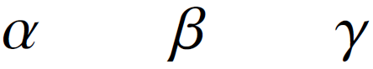
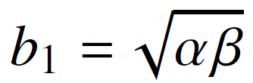
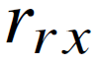
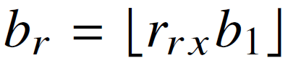
Channel Modeling - LoS Probability
Three Environment Parameters
: the ratio of land area covered by buildings to total land area
: the mean number of buildings per unit area [buildings/km²]
: a variable determining the building height distribution
Expected number of buildings passed per km:
Number of buildings in :
Propagation data and prediction methods required for the design of terrestrial broadband radio access systems operating in a frequency range from 3 to 60 GHz, ITU-R, p.1410-5, Feb, 2012.
Notes:
$b_{r}$: number of buildings crossed

Slide 27
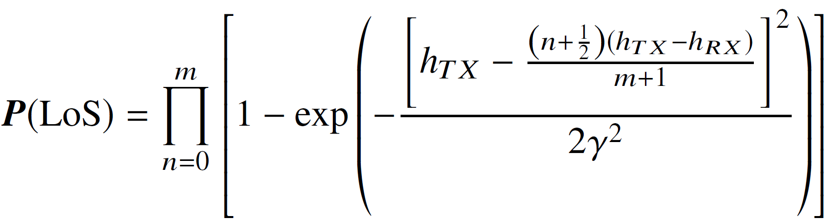
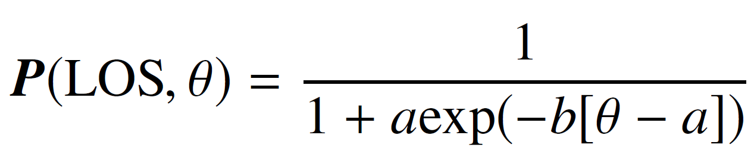
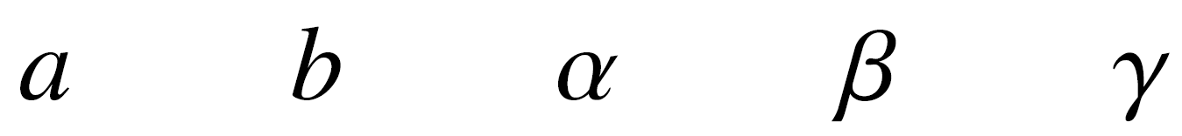
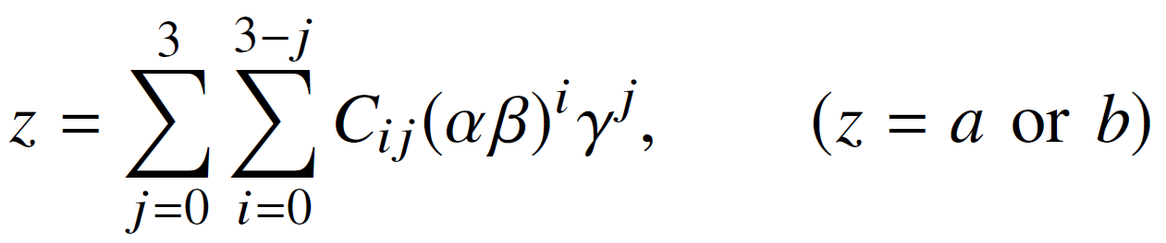
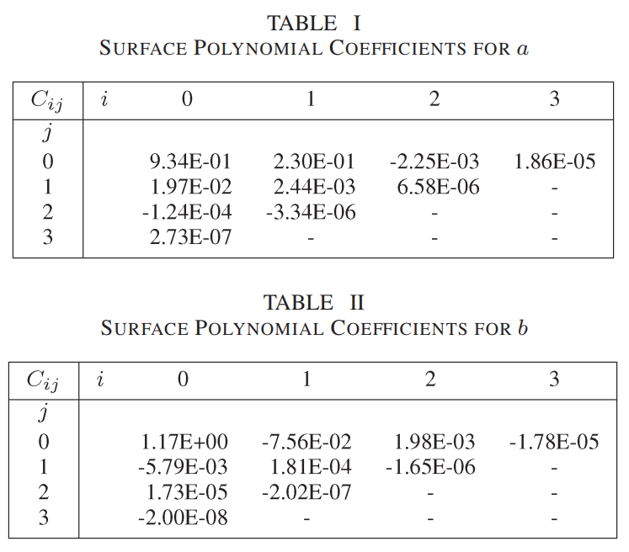
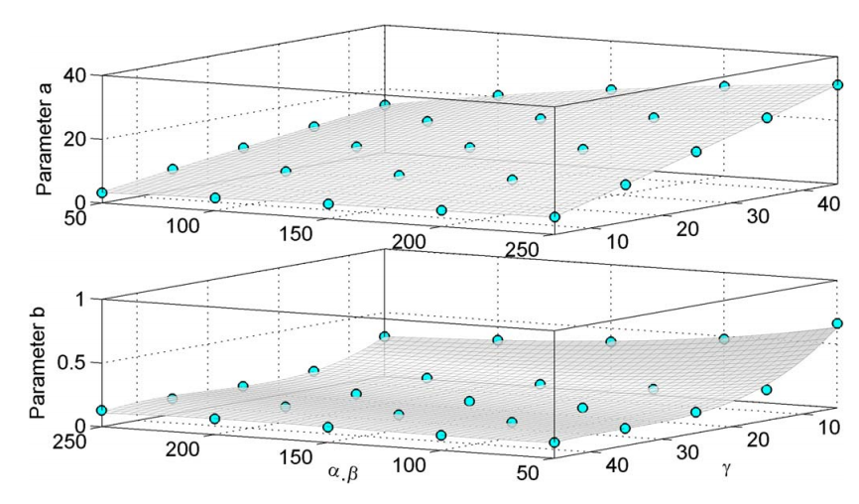
Channel Modeling - LoS Probability
Approximated LoS Probability
Parameters and are directly linked to the environment variables , , and
Obtained by Surface fitting:
Similar to Sigmoid function
Al-Hourani, Akram, Sithamparanathan Kandeepan, and Simon Lardner. "Optimal LAP altitude for maximum coverage." IEEE Wireless Communications Letters 3.6 (2014): 569-572.

Slide 28
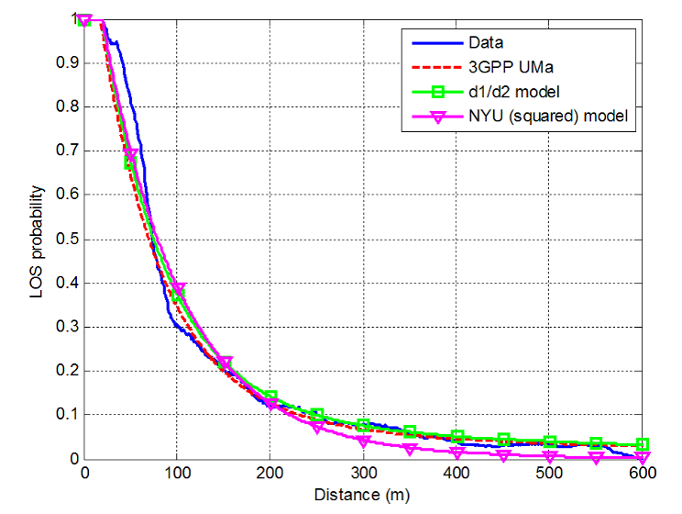
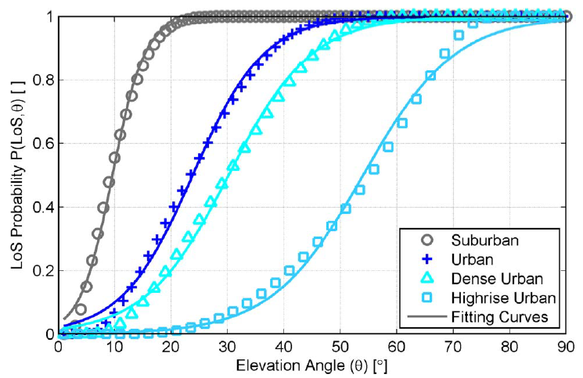
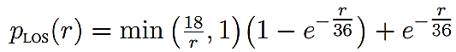
LoS Probability
LoS Probability for 3GPP LoS/NLoS model
Increasing LoS Probability with BS Height
LoS Probability for 3GPP LoS/NloS Model^{[Kat:16]}
3D-based LoS Probability^{[Akr:14]}
Decreases with BS Height
Increases with BS Height
[Kat:16] Haneda, Katsuyuki et al. “5G 3GPP-like Channel Models for Outdoor Urban Microcellular and Macrocellular Environments.” VTC Spring (2016).
[Akr:14] Al-Hourani, Akram, Sithamparanathan Kandeepan, and Simon Lardner. "Optimal LAP altitude for maximum coverage." IEEE Wireless Communications Letters 3.6 (2014): 569-572.

Slide 29
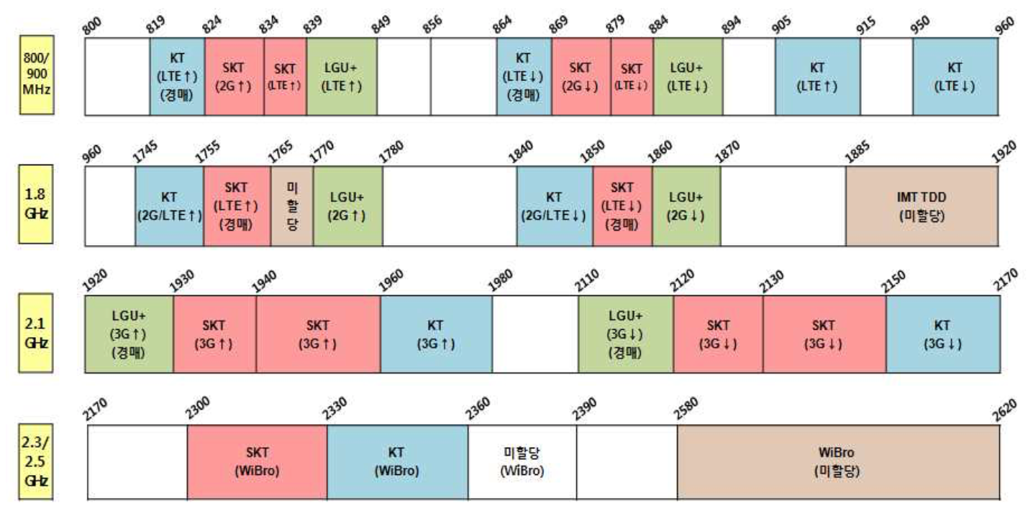
Interference
Frequency Allocation per Frequency Band

Slide 30
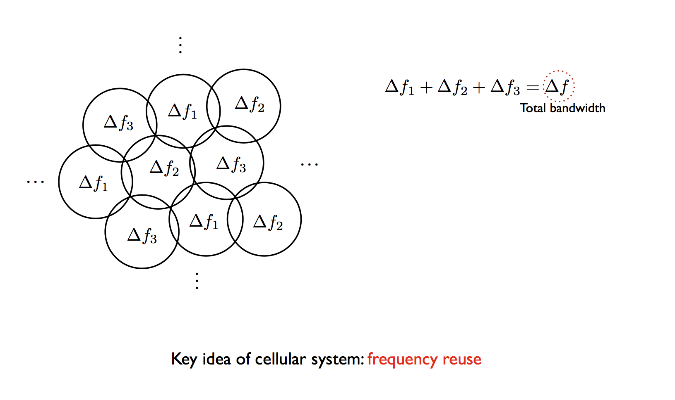
Interference
Co-Channel Interference

Slide 31
Interference
Co-Channel Interference and Frequency Reuse

Slide 32
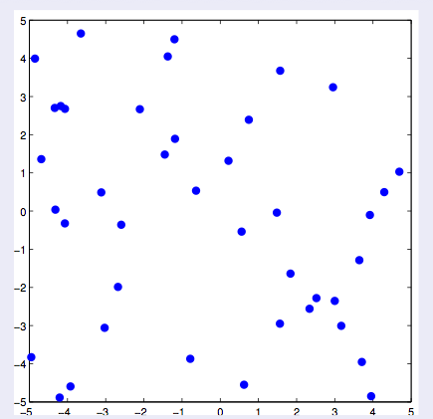
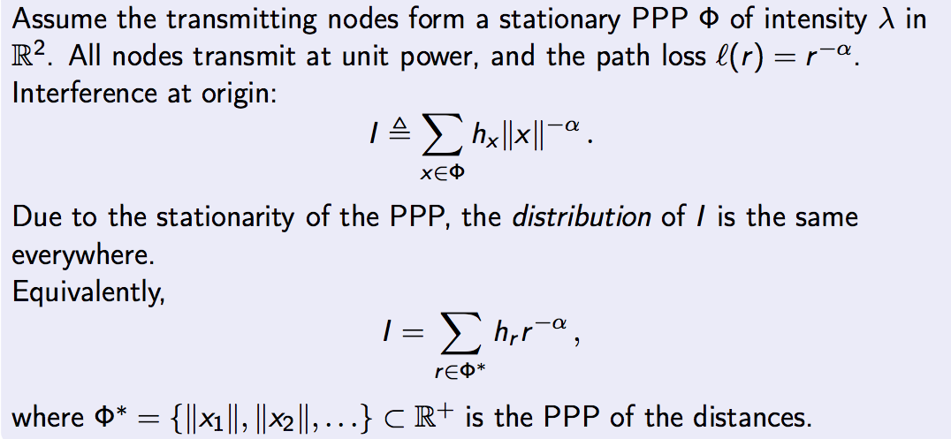
Interference
Exercise: Assume the transmitting nodes from a stationary PPP of intensity in . All nodes transmit at unit power, and the pathloss is . The interference at origin is
where is the PPP of the distance
Due to the stationarity of the PPP, the distribution of the interference is the same everywhere.

Slide 33
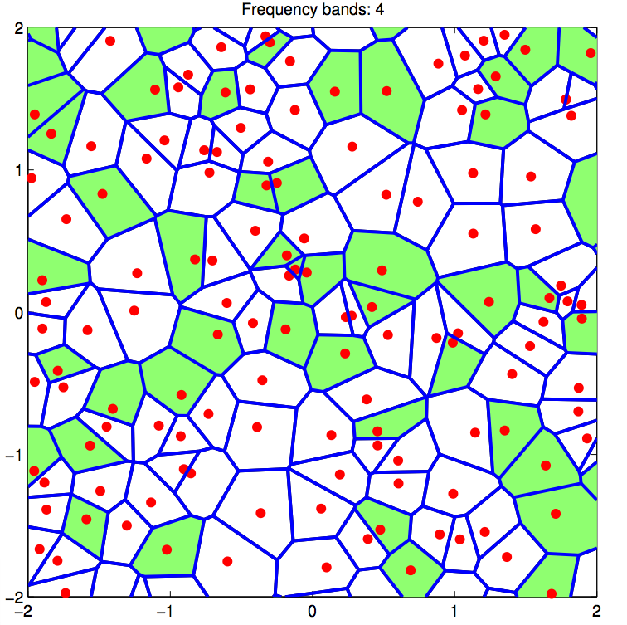
Interference
Frequency allocation and planning is necessary for the coverage
As it affects the interference
For frequency bands, we can simply consider the random allocation of bands
Corresponds to the thinning of a PPP
So, the density of BSs using
the frequency band m is
We first consider the nearest BS
to the MS at the origin
Distance distribution of main link
Interferer density

Slide 34
Part 3
UDN Performance

Slide 35




System Model
Channel Modeling
Pathloss exponent $2≤α^{(L)}≤α^{(N)}$
LoS: 2.5, NLoS: 4
Nakagami-m fading for LoS and NLoS channels
Channel gain of (C),
Shape parameter $1≤m^{(N)}≤m^{(L)}$
$m=1,$ then, $→$Exponential Distribution for NLoS channel
Bigger $m$ results in smaller variance $→$ LoS channel
Received Power
Received power of the user
$x$: Link distance
$c_{o}∈\left\{L, N\right\}$: Representing whether channel is LoS/NLoS

Slide 36




System Model
Association Rule
Strongest average received power based association
$x_{main}$ and $x_{rec}$ are coordinates of the main link transmitter and the receiver
$α_{x}$ is pathloss of the corresponding transmitter $x$
Both LoS and NLoS channel are considered
Interference
The interference from the k-tier under channel environment $c_{o}$
Sum of interference and noise
$σ^{2}$ : Noise

Slide 37



Coverage Probability Analysis
Coverage Probability
The coverage probability when the main link transmitter is in j-tier under channel c is selected with distance d
$β$ : SINR threshold
f is SINR when the main link transmitter is in the j-tier under channel c with distance d

Slide 38



Area Spectral Efficiency
Area Spectral Efficiency (ASE)
The ASE [bps/Hz/$m^{2}$] of j-tier network
$$ASE_{j}=λ_{j}\int_{β_{0}}^{∞}{\log_{2}\left(1+β\right)f_{j}\left(β\right) dγ}$$
$$f_{j}\left(β\right)$$
$β_{0}$ : Target SINR threshold of the STP
The ASE of the UDN

Slide 39



Any Questions?
THANK YOU
Email : jmnlee@digist.ac.kr
Information Security and Communications (ISC) Lab.

